Slide 1
US Economic Dashboard Project 2
Team Members: Jake Geiser, Jillian Gonder, Dave Moorman and Caitlin Smith

Slide 2
Theme
Our goal was to investigate the current state of the US economy and its impact on US citizens.
Focused on the Misery Index and provided a stock search and plot generator
Web-scraped economic news from CNBC.com
Presented on an interactive website (to be demonstrated at the end of the presentation)

Slide 3
Approach
Used an API from Quandl.com
Create the latest Misery Index plot
Power the stock search and plot generator
Implemented a Calendar Date Range Picker on the stock search from a JQuery library found on http://www.daterangepicker.com/#examples and from https://momentjs.com/
Web Scraped Economic News from CNBC.com to get the latest article and image for the website
Stored web scraping results in a MongoDB unstructured database
Developed a website using d3, JavaScript, and CSS
Flask was utilized to power the backend to the frontend website

Slide 4
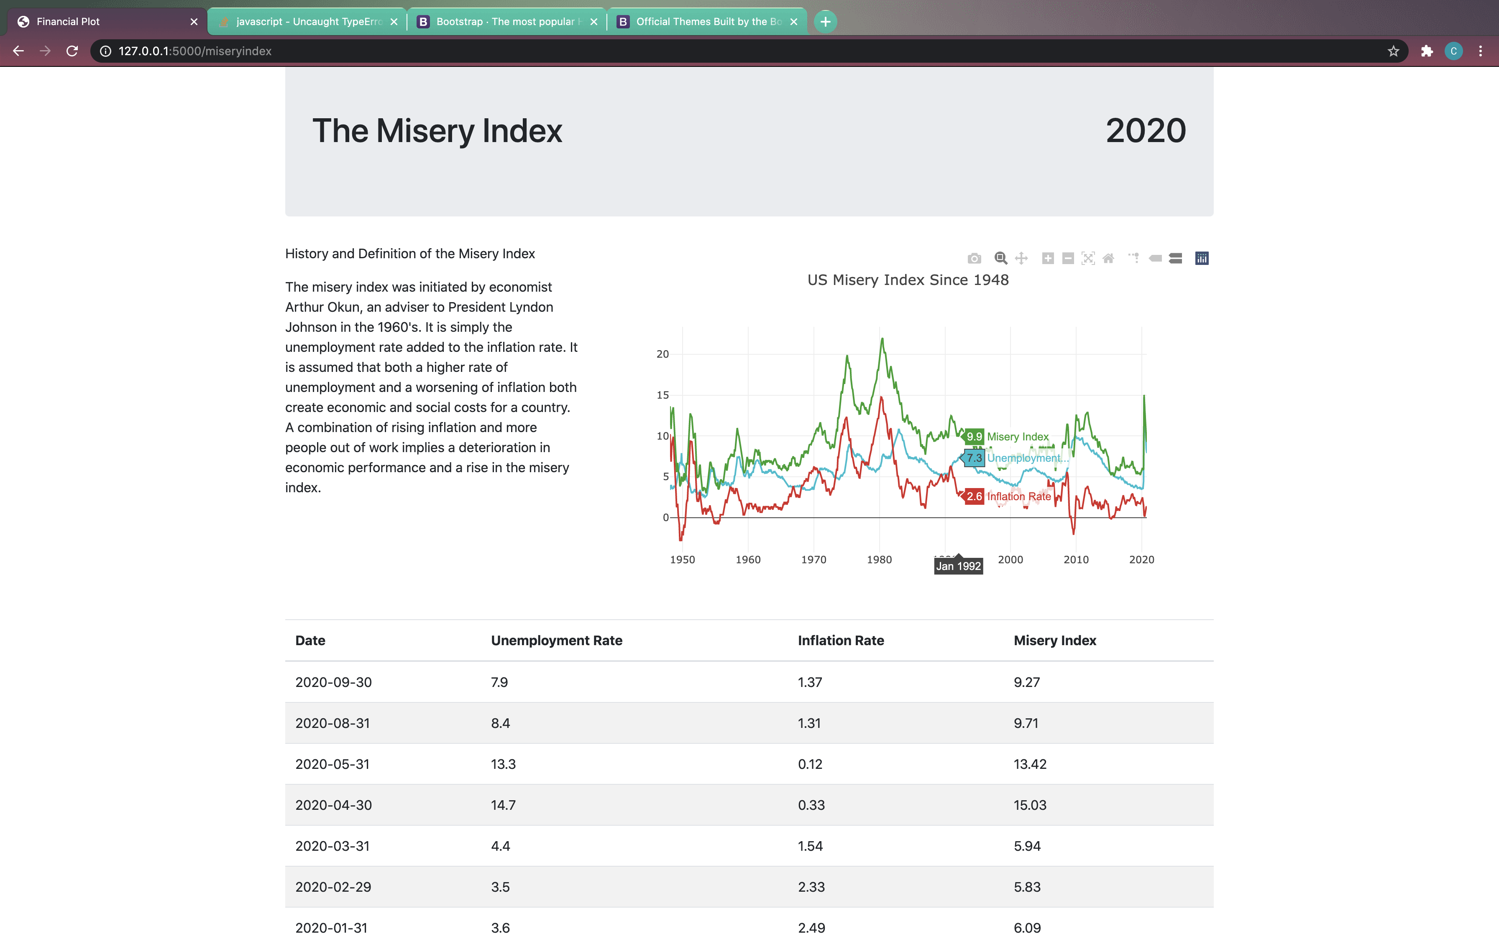
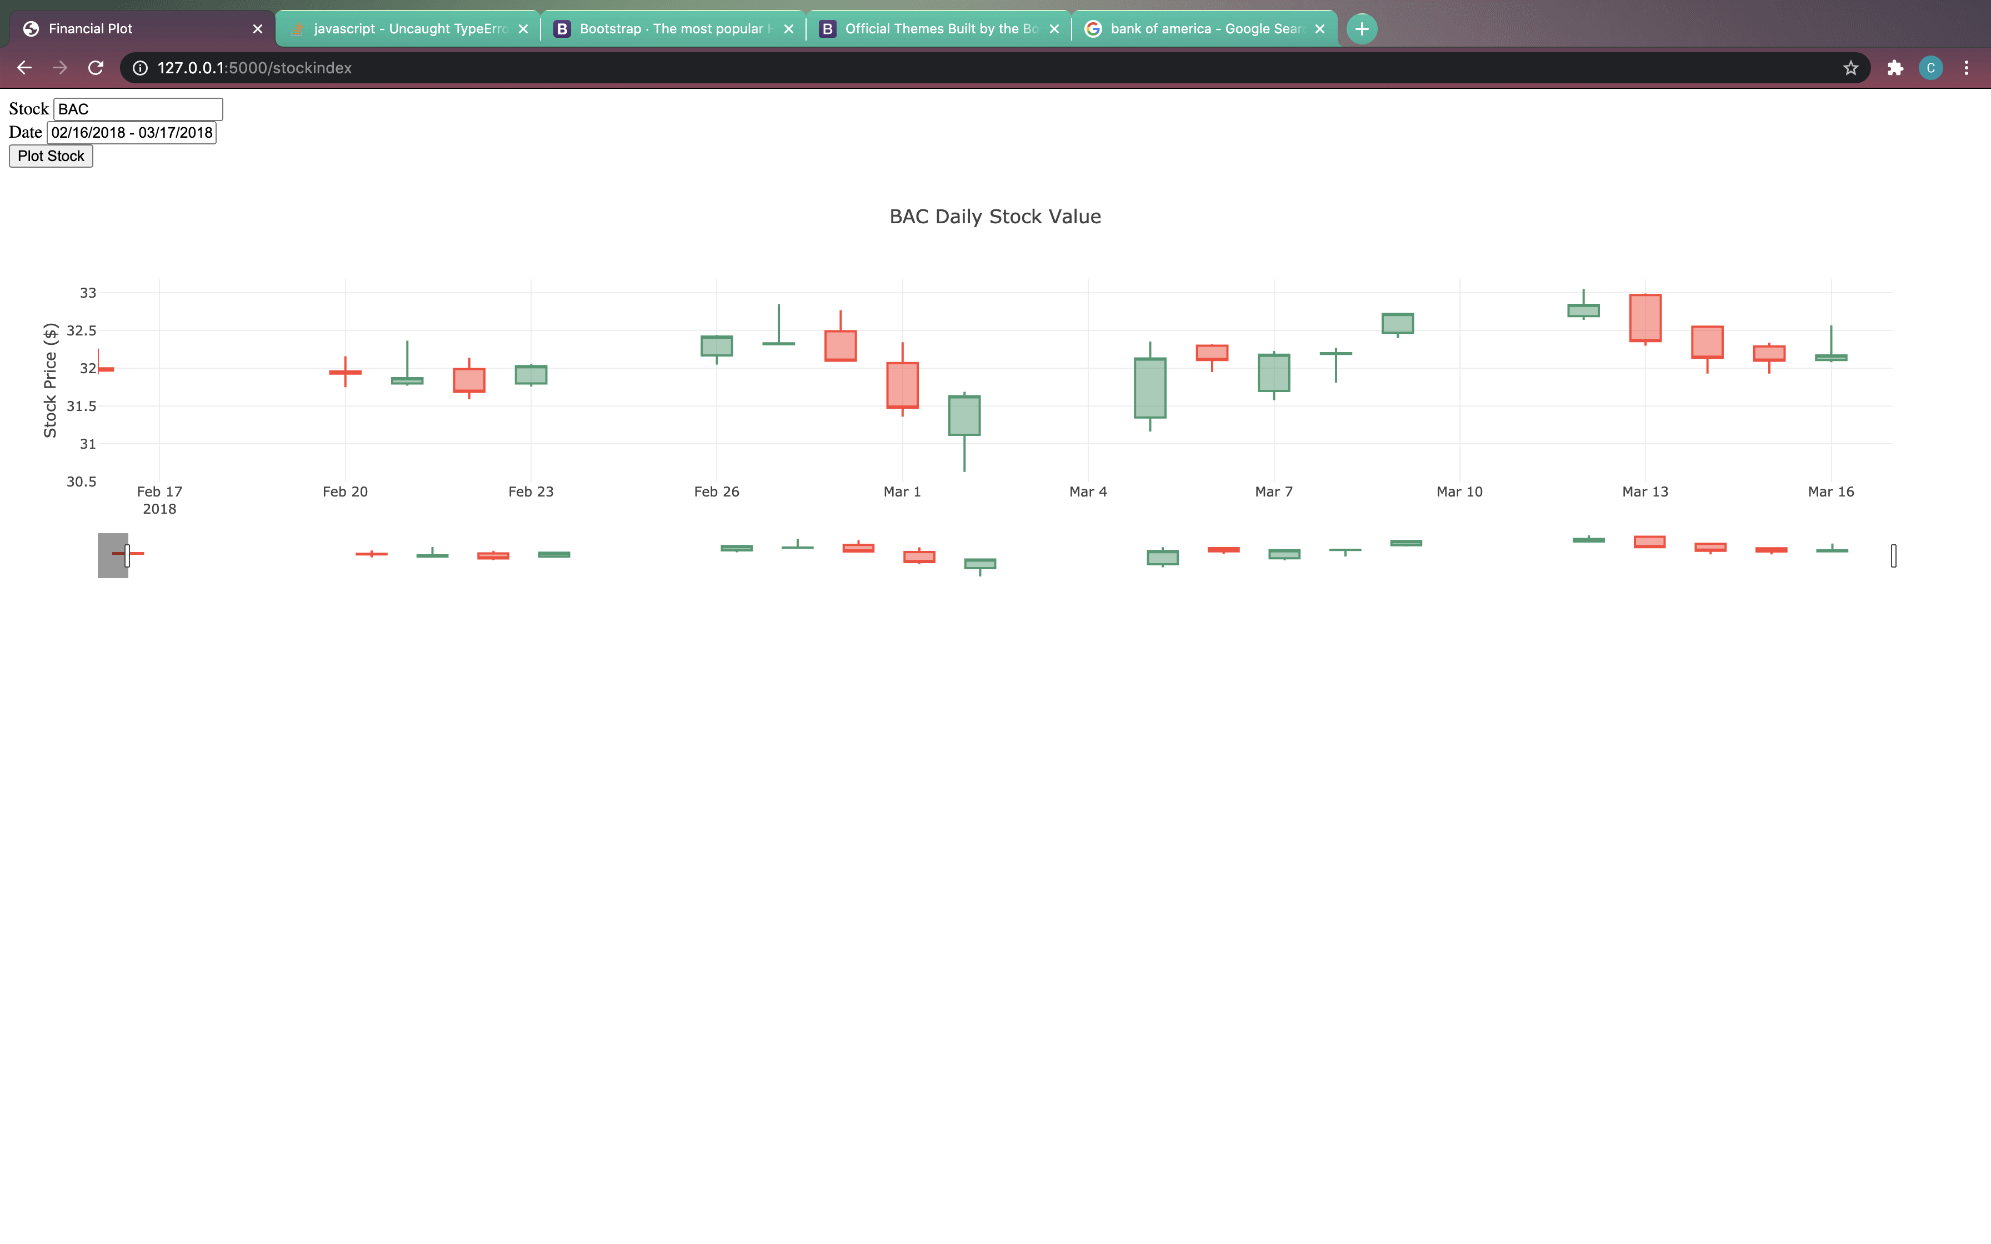
API for Interactive Charts
Interactive chart showing historical data utilizing API
Stock search and plot generator

Slide 5
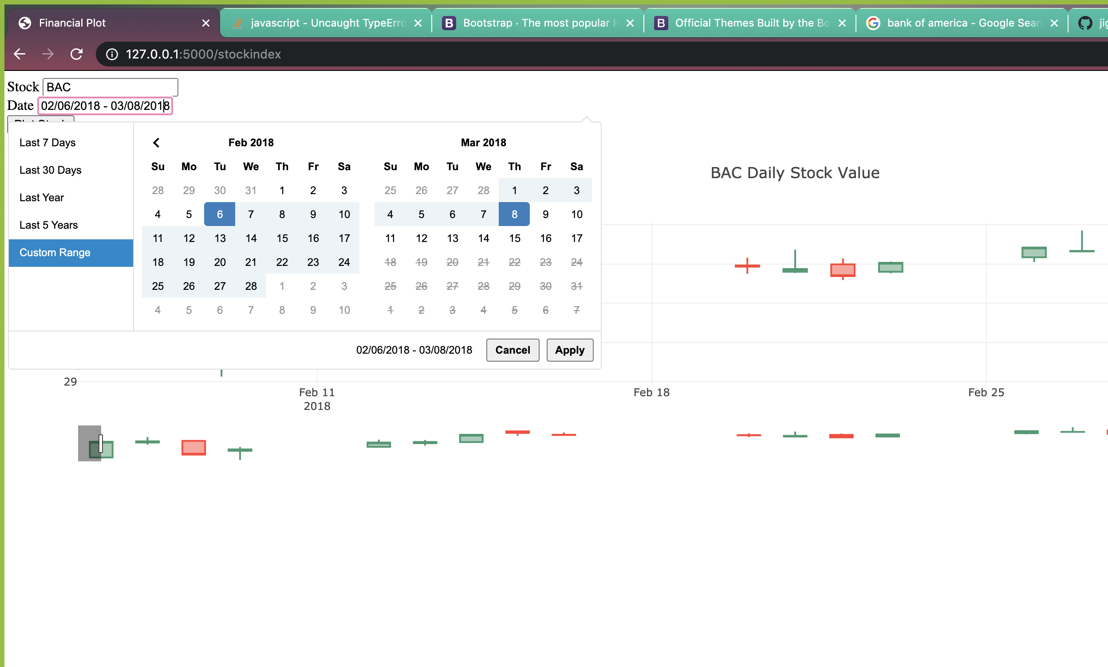
JQuery Library Applied
Implemented a Calendar Date Range Picker
Sources:
http://www.daterangepicker.com/#examples
https://momentjs.com/

Slide 6
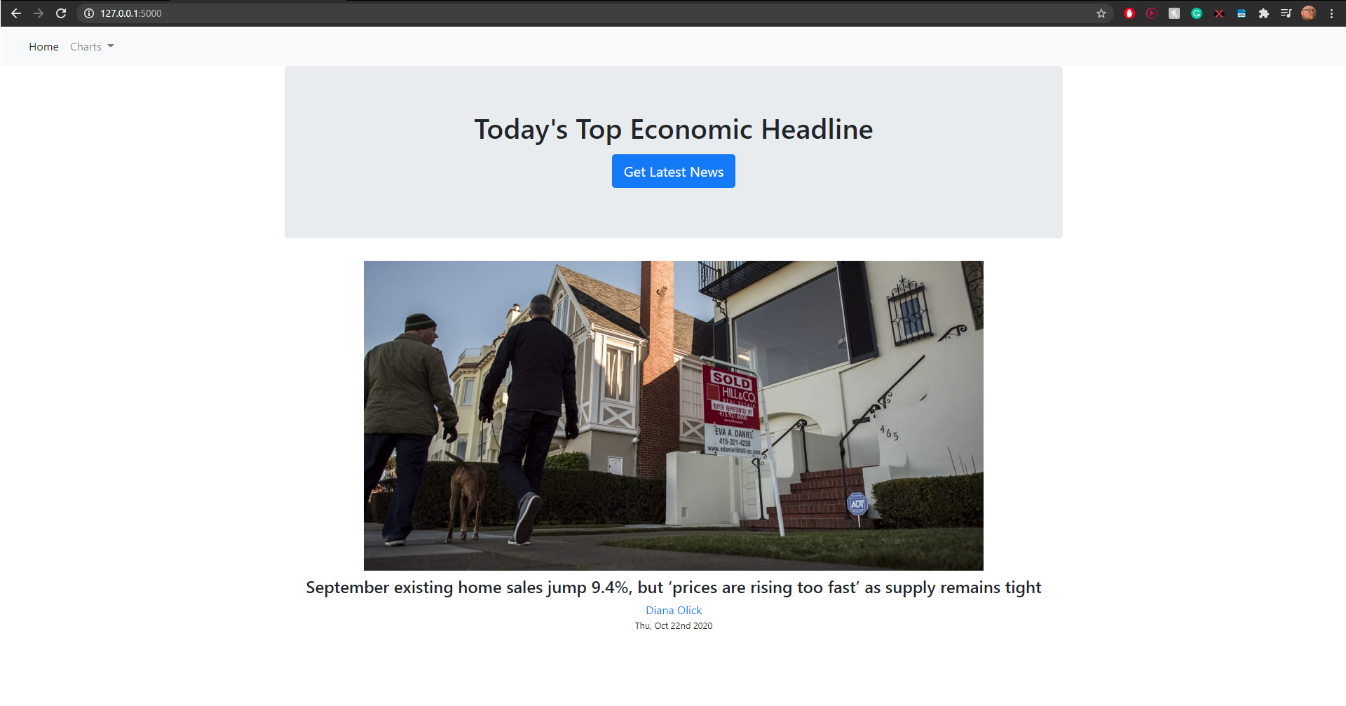
Web Scraping
Web-scraped news from CNBC site
Used MongoDB for storing results

Slide 7
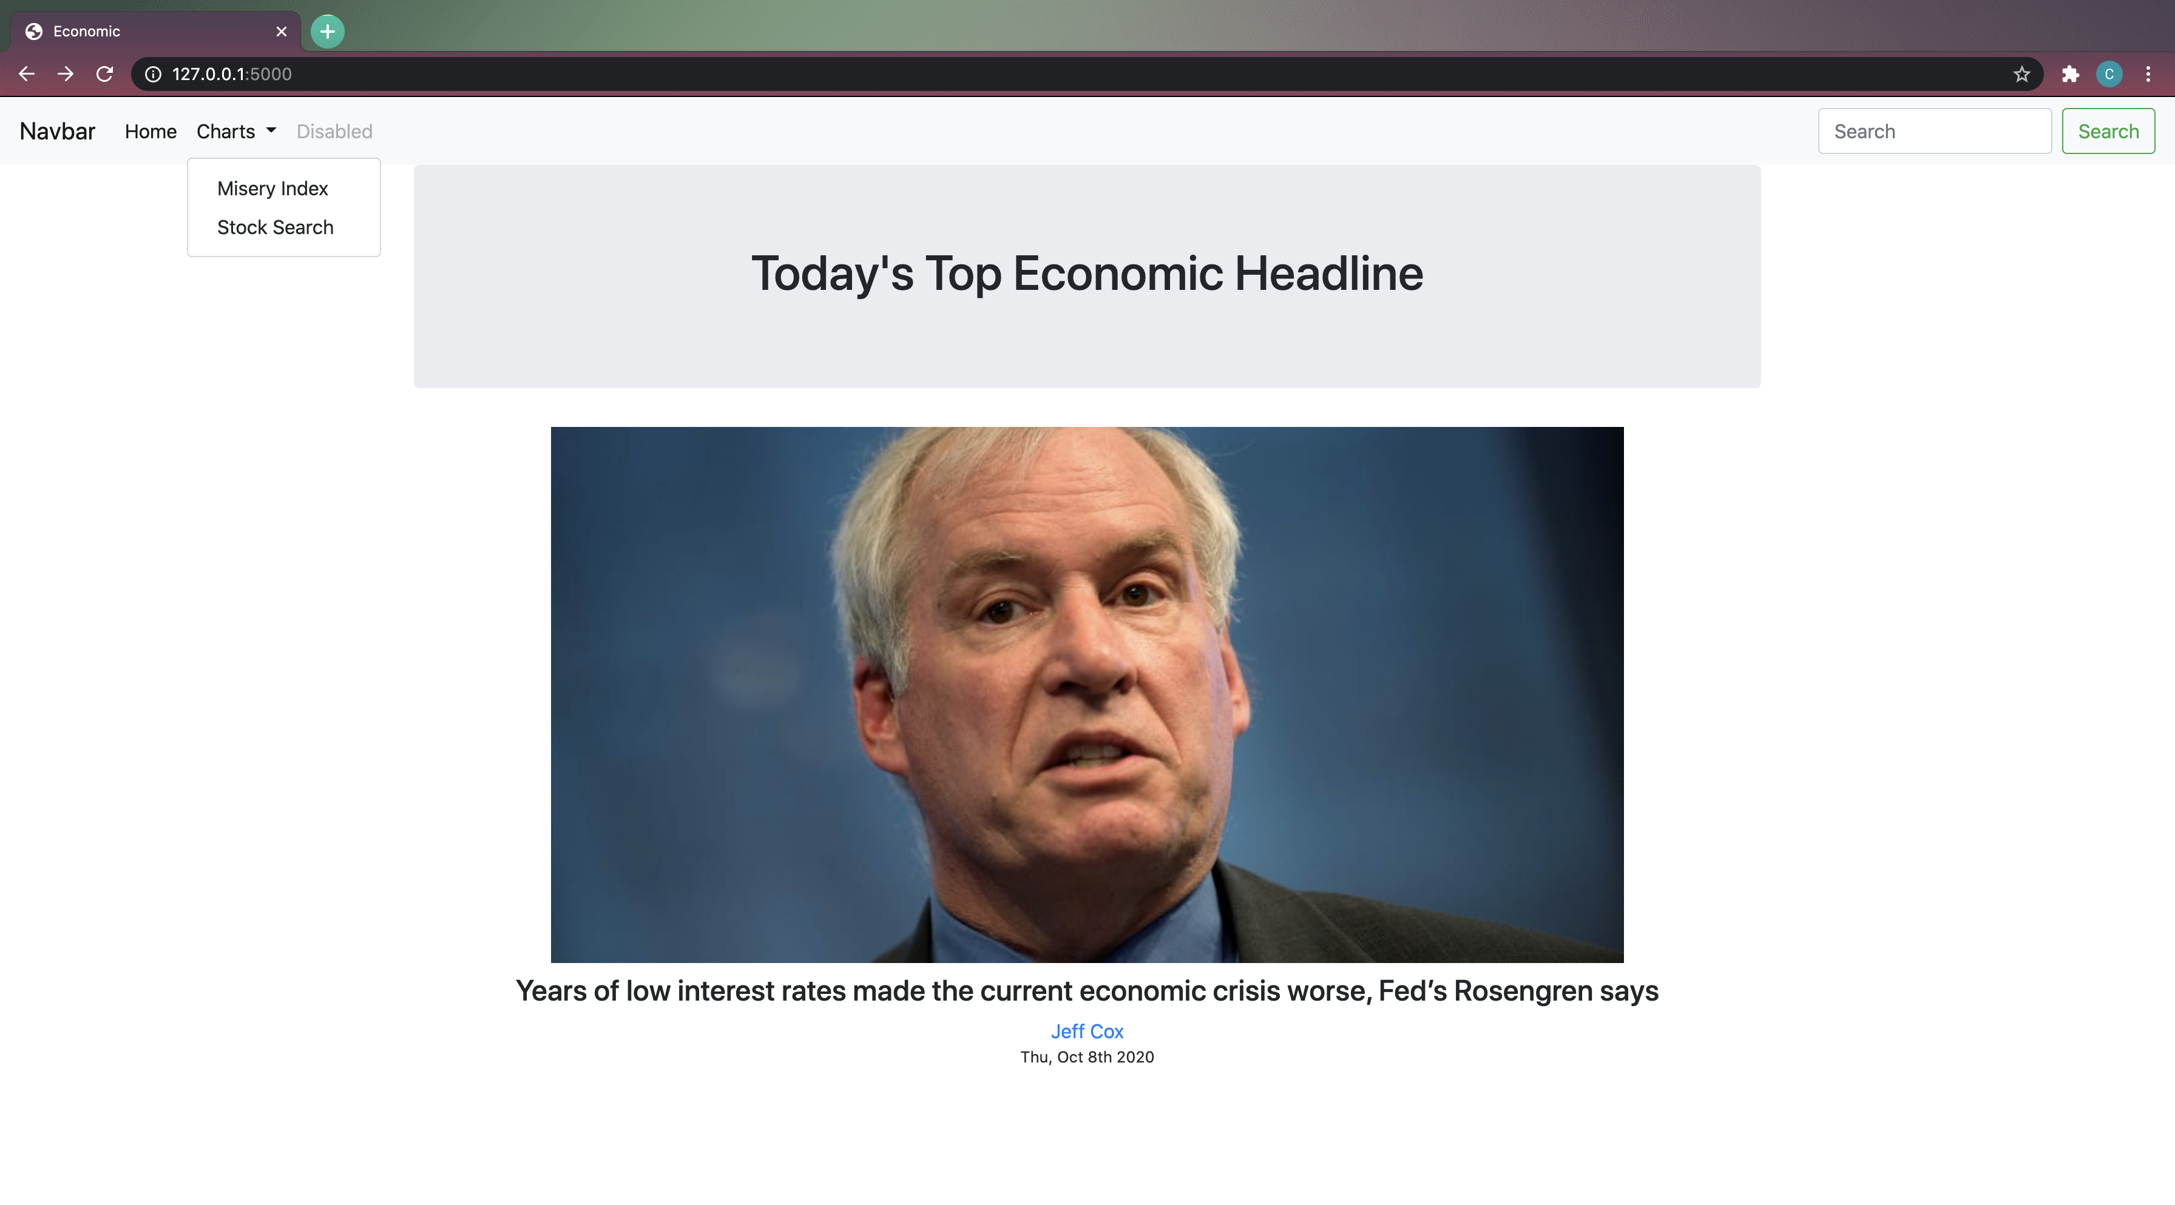
Website
Interactive Drop Down
Used JavaScript and CSS with Bootstrap to develop the site
Utilized Flask to tie the backend to the frontend webpage

Slide 8
Demo

Slide 9
Final Thoughts
Free APIs may provide limited data

Slide 10
Appendix

Slide 11
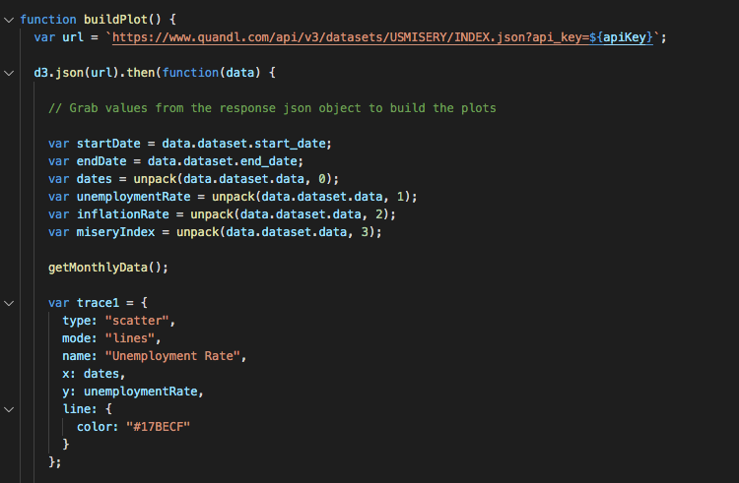
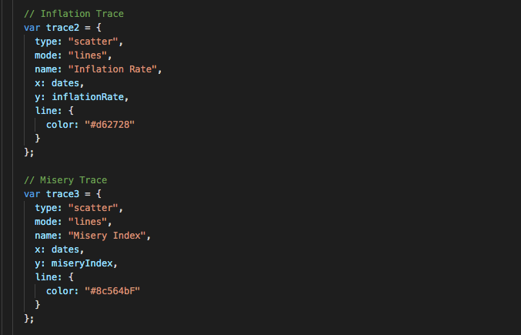
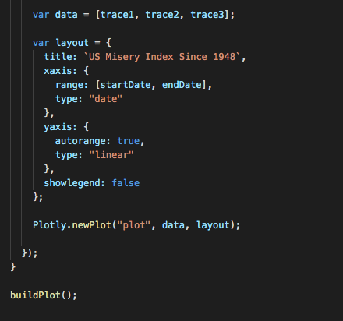
Coding Approach
Data Gathering
Pulled Misery Index data from Quadl.com to create plots

Slide 12
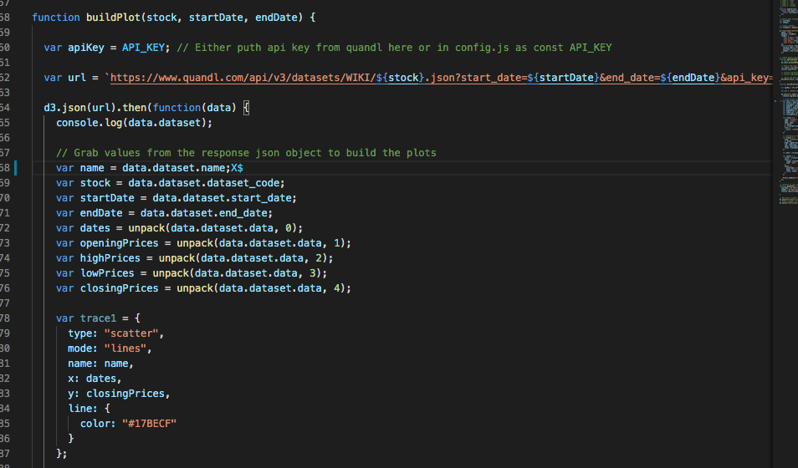
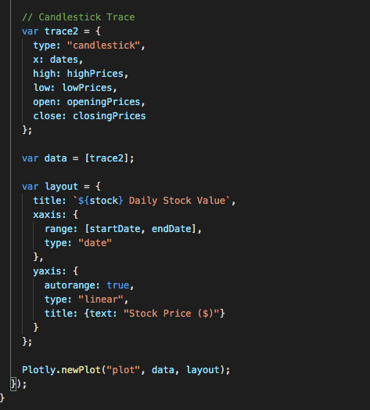
Coding Approach
Pulled stock data from Quadl.com to create plots

Slide 13
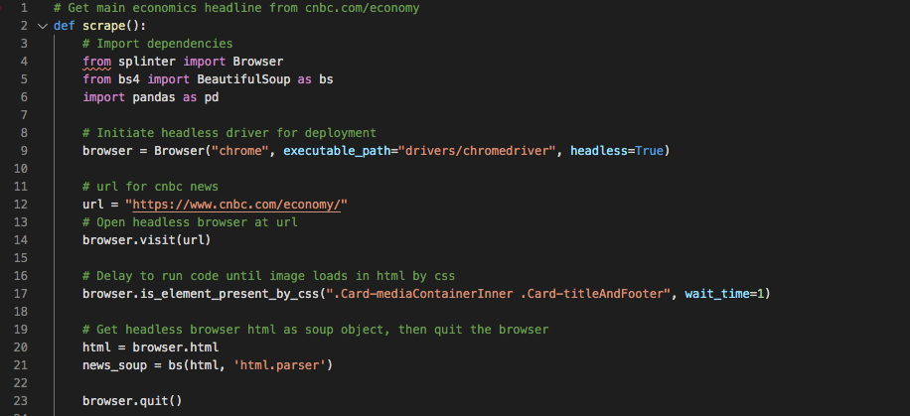
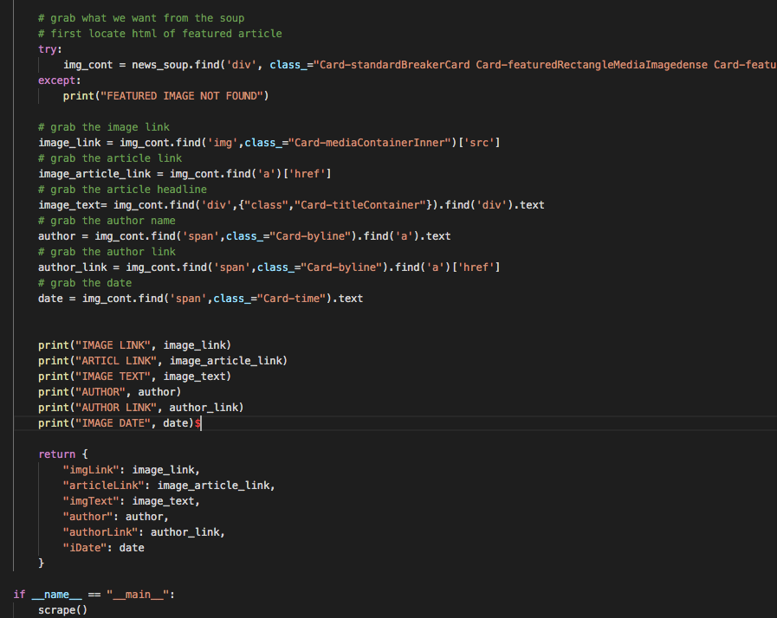
Coding Approach
Used web scraping to pull info from www.cnbc.com/economy

